Slide 1

Genetic Algorithms Optimizers

Slide 2
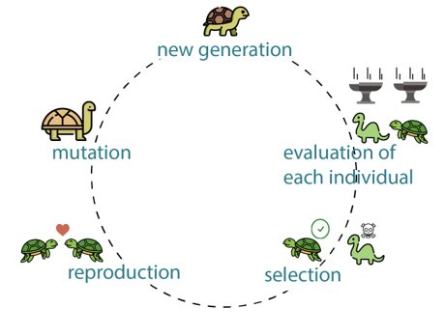
Genetic Algorithms: Overview
Why Genetic Algorithms?
Metaheuristic algorithms stem from biological evolution.
Preferred for non-differentiable, expensive to differentiate, or objective functions with no intrusive access (black-box).
Doesn’t get stuck in local minima, and hence works with non-convex problems.
Can handle both constrained and unconstrained problems.
Due to the encoding/decoding step it works with discrete, continuous, or mixed design spaces, with binary, integer, real, gray, or permutation encoding.
2

Slide 3
Notation
 | G1 | G2 | G3 | G4 | G5
ch1
ch2 | 2 | 5 | 1 | 8 | 4
ch3
ch4
ch5
ch6
ch7
Chromosome/individual (possible solution)
2 | 5 | 1 | 8 | 4
Population
2
Gene (variable)
2
Allele (value of variable)
3

Slide 4
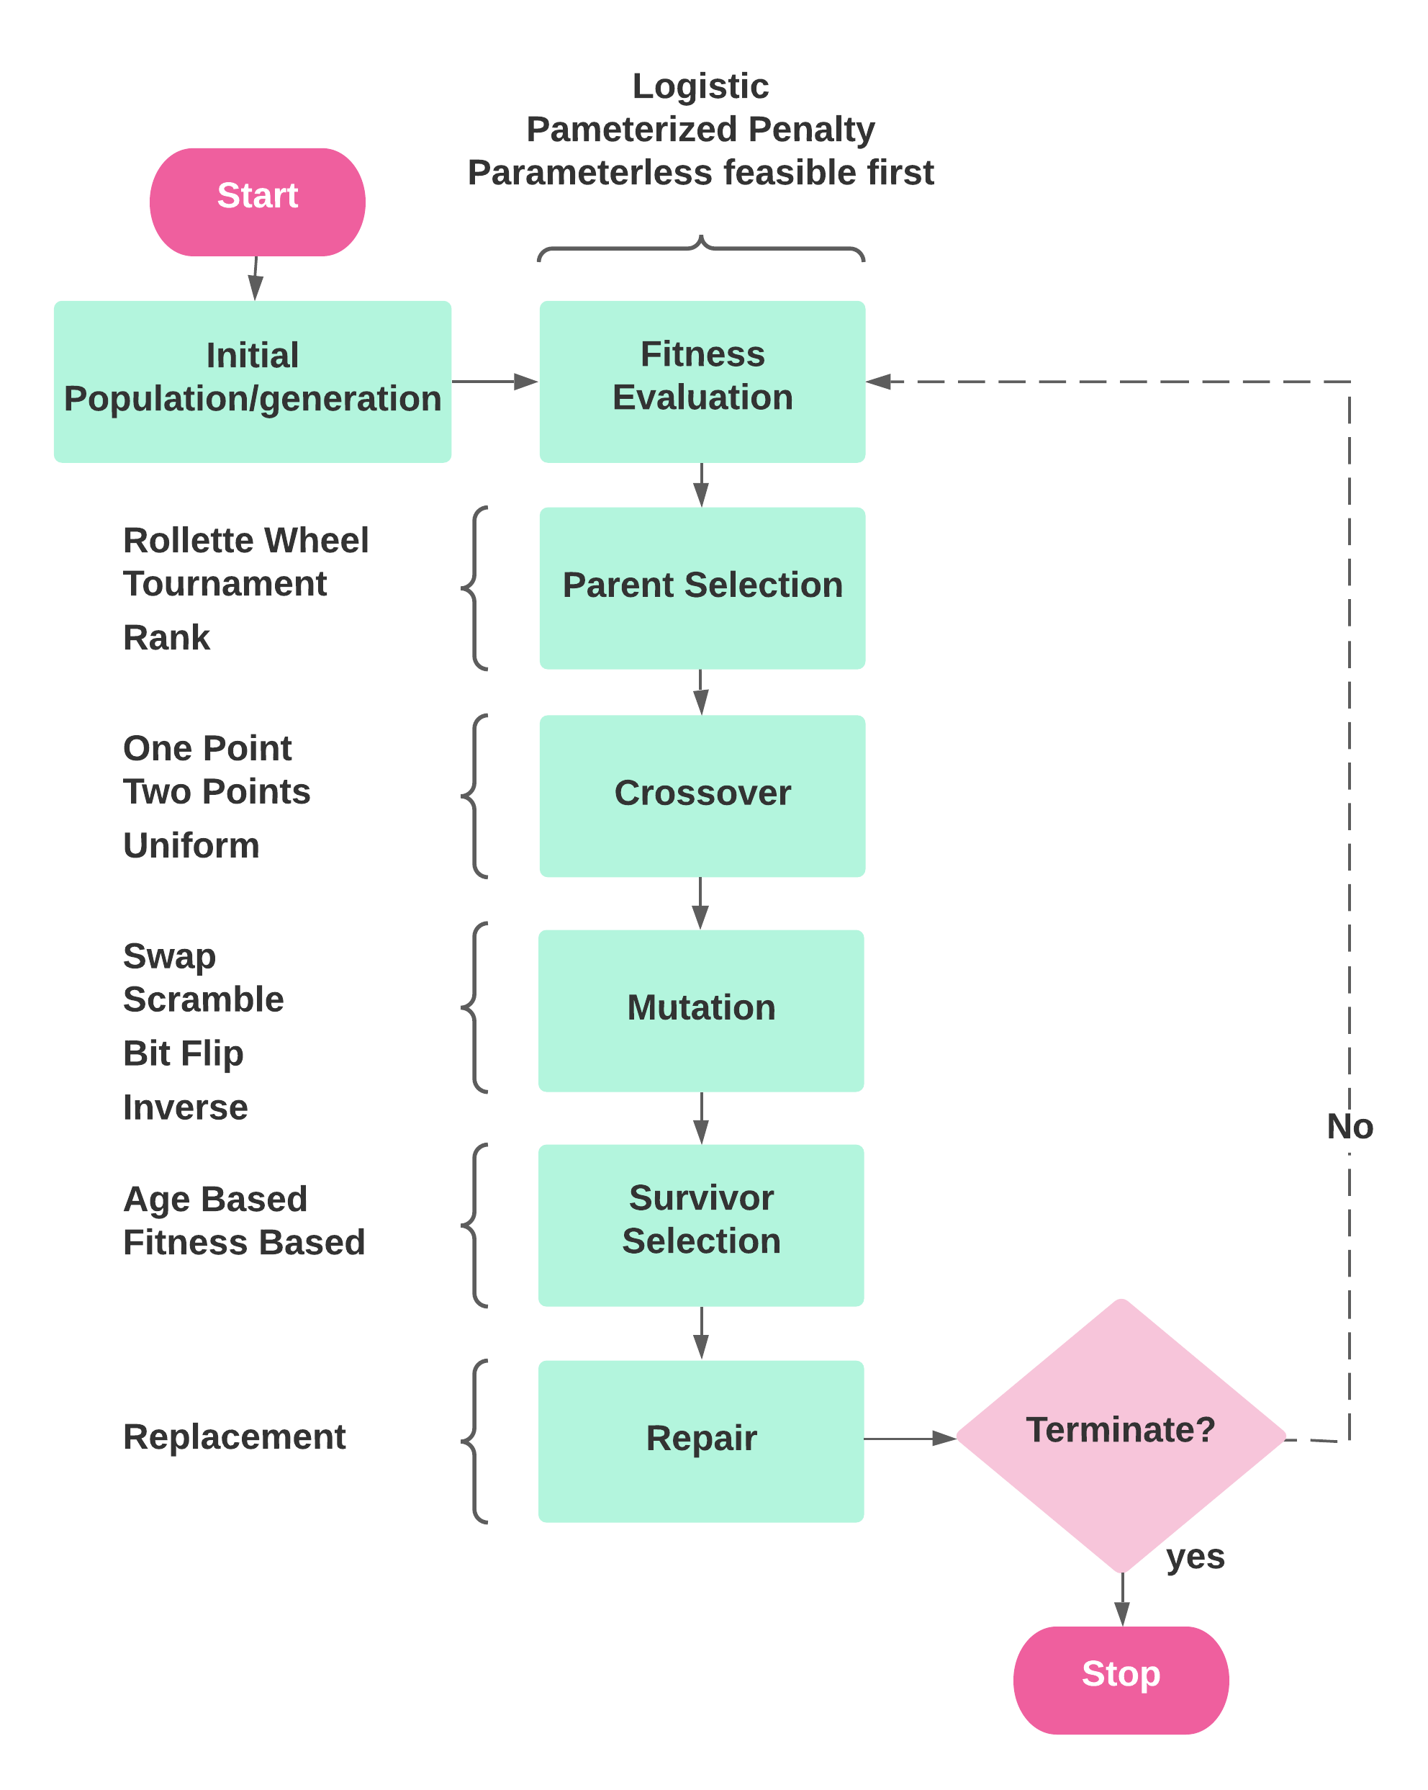
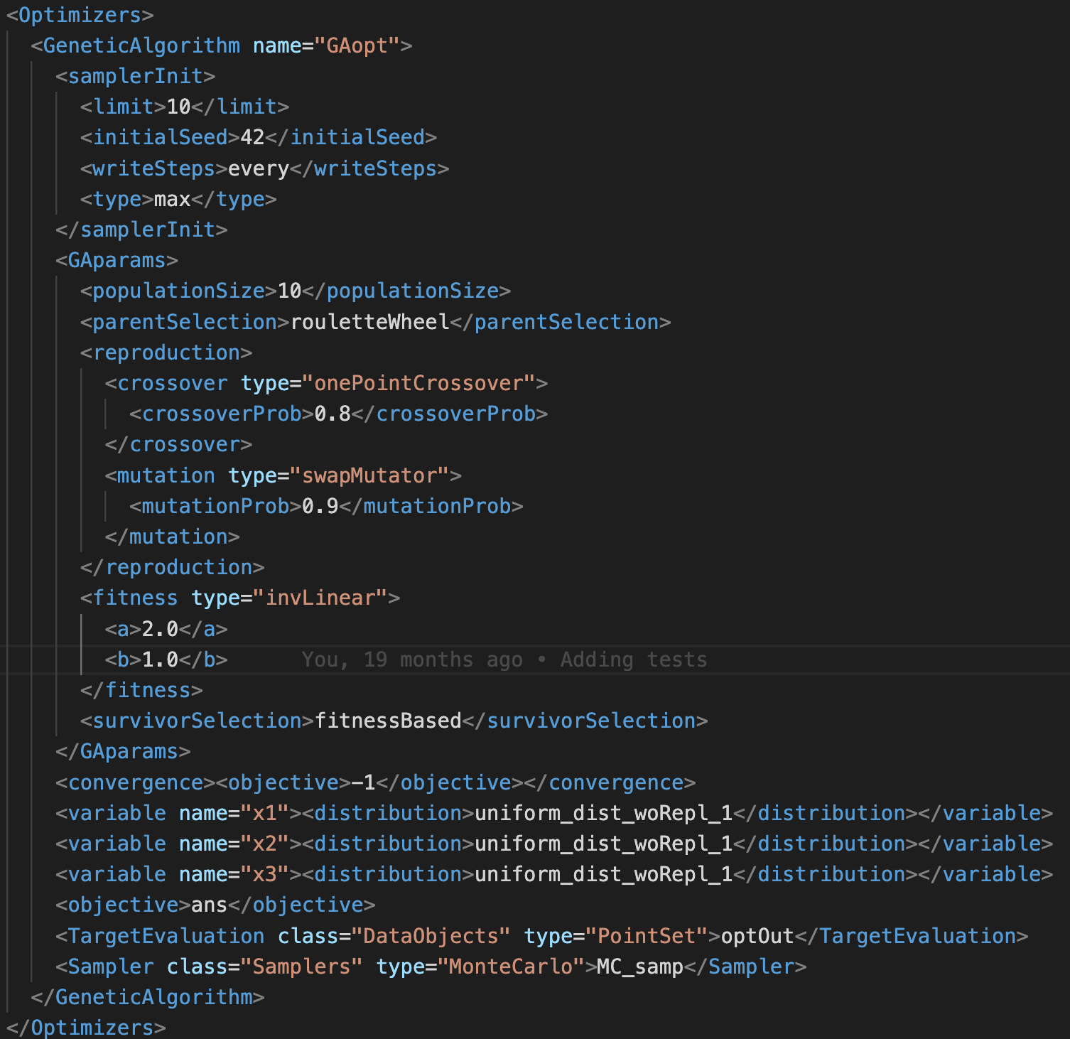
Flowchart and Corresponding Input
4

Slide 5
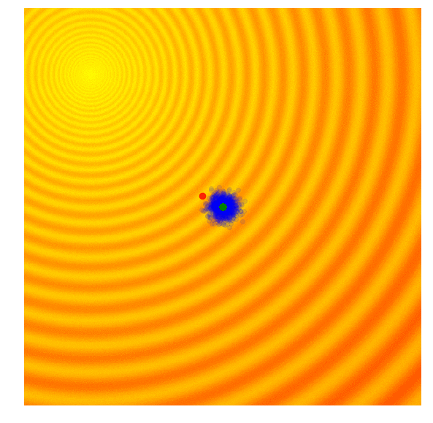
Overview of GAs
Encoding/decoding: Phenotype/Genotype variable representation (binary, integer, permutation, or real representation).
Steps
Create initial population
Fitness evaluation
Parent selection
Crossover: creation of offsprings
Mutation: creation of mutated offsprings
Replacement/repair
Survivor selection
If Termination condition(s) is met terminate, else repeat Steps 3 through 7 (each iteration is a generation).
Source: A Visual Guide to Evolutionary Strategies. https://blog.otoro.net/2017/10/29/visual-evolution-strategies.
5

Slide 6
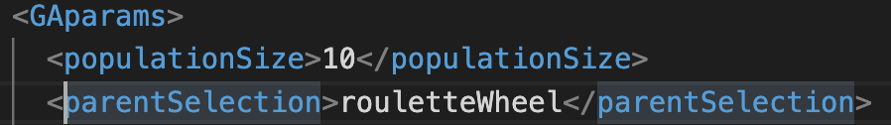
Evolutionary Operators of GAs
Parent selectors:
Roulette Wheel
Tournament Selection
Rank Selection
Individual | Fitness
P1 | 5
P2 | 8.2
P3 | 1.4
P4 | 0.98
P5 | 2
P6 | 2.3
6

Slide 7
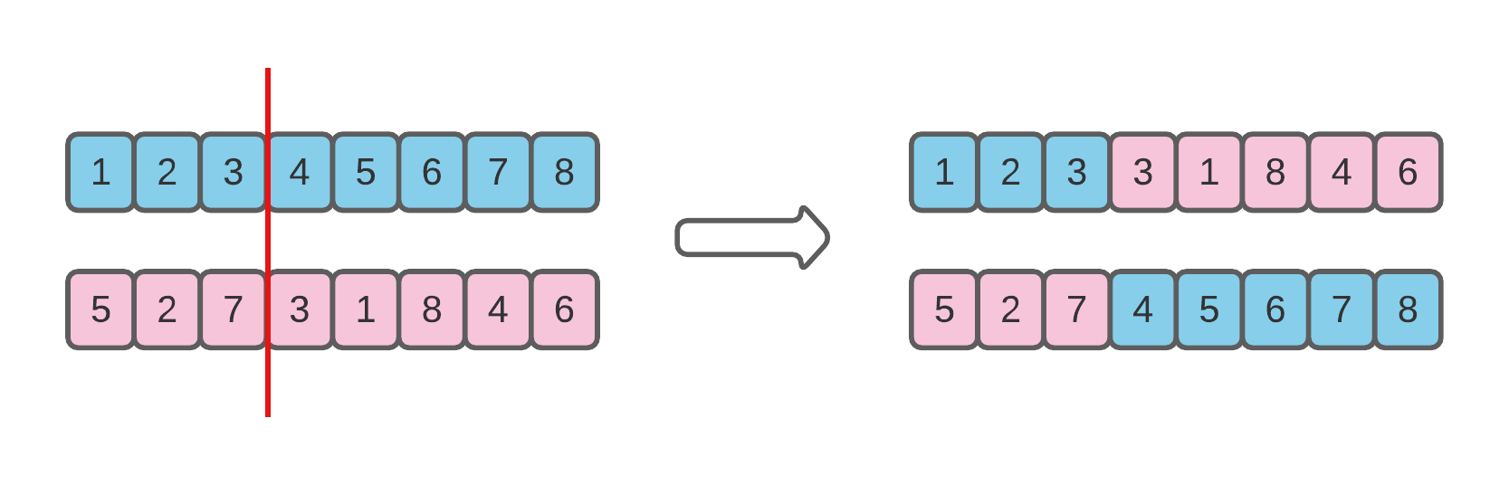
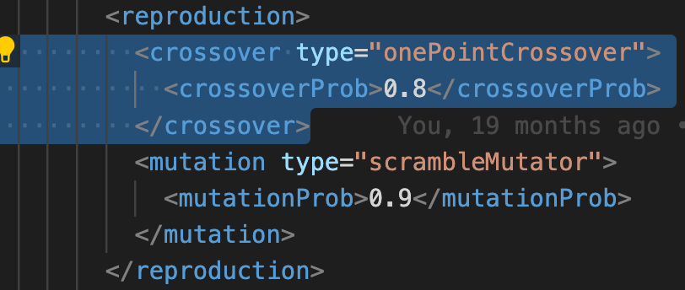
Evolutionary Operators of GAs
Crossovers:
One Point
Two points
Uniform
7

Slide 8
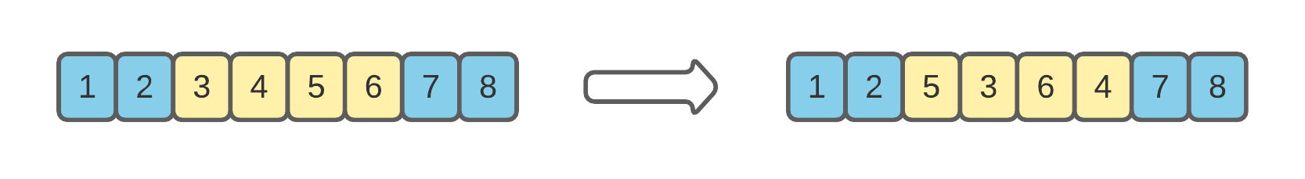
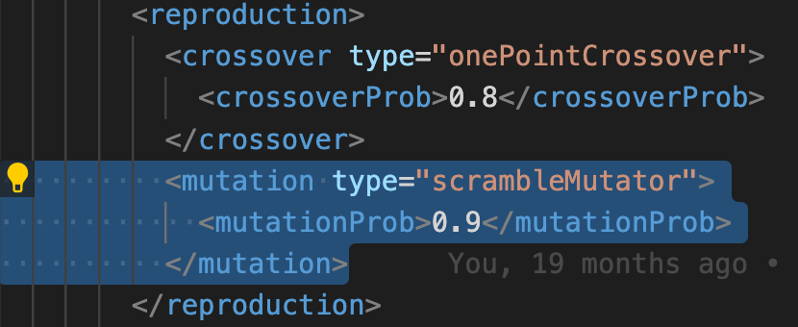
Evolutionary Operators of GAs
Mutators:
Swap Mutation
Scramble Mutation
Bit Flip Mutation
Inversion Mutation
8

Slide 9
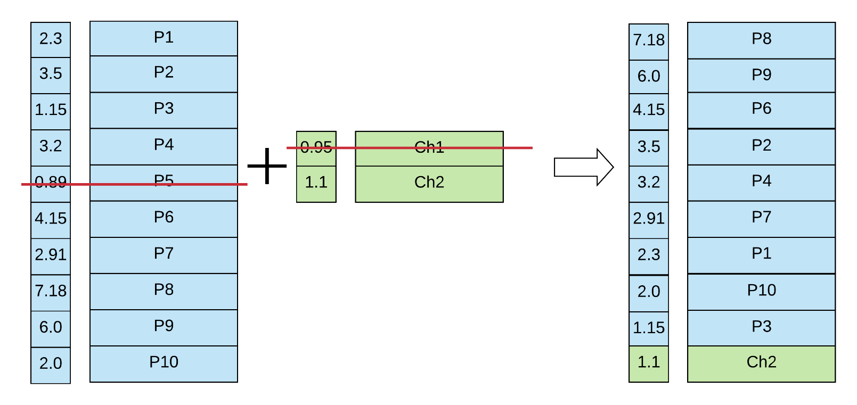
Evolutionary Operators of GAs
Survivor selection:
Fitness Based
Age Based
Fitness
Fitness
Chromosome
Chromosome
Fitness
Chromosome
offsprings
Generation/population i
Generation/population i+1
9

Slide 10
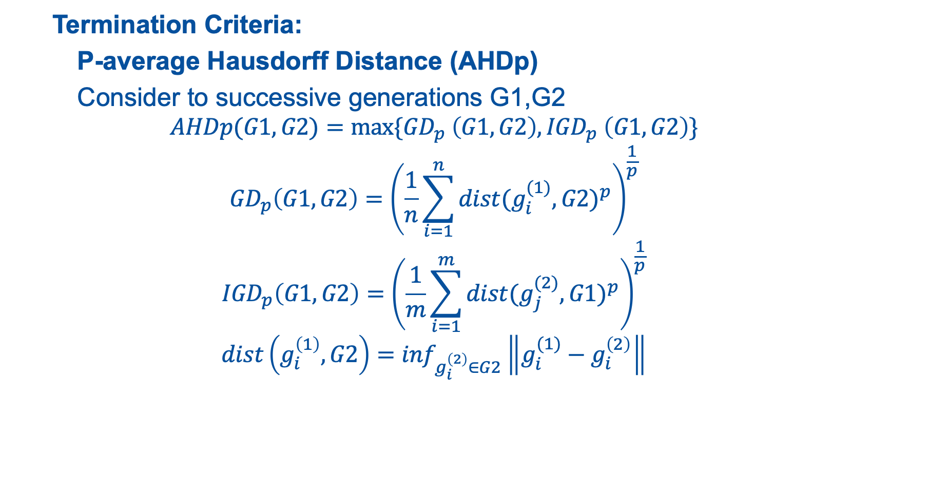
Evolutionary Operators of GAs
Termination Criteria:
P-average Hausdorff Distance (AHDp)
Consider to successive generations G1,G2
$$AHDp(G1,G2)=max⁡\{{GD}_{p} \left(G1,G2\right),{IGD}_{p} \left(G1,G2\right)\}$$
$${GD}_{p}\left(G1,G2\right)={\left(\frac{1}{n}\sum_{i=1}^{n}{{dist(g_{i}^{(1)},G2)}^{p}}\right)}^{\frac{1}{p}}$$
$${IGD}_{p}\left(G1,G2\right)={\left(\frac{1}{m}\sum_{i=1}^{m}{{dist(g_{j}^{(2)},G1)}^{p}}\right)}^{\frac{1}{p}}$$
$$dist\left(g_{i}^{\left(1\right)},G2\right)=\inf_{g_{i}^{\left(2\right)}∈G2}\left\|g_{i}^{(1)}−g_{i}^{\left(2\right)}\right\|$$
10

Slide 11
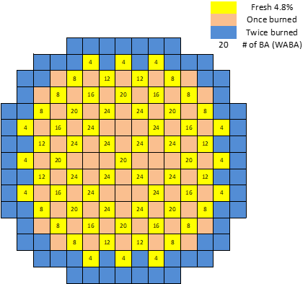
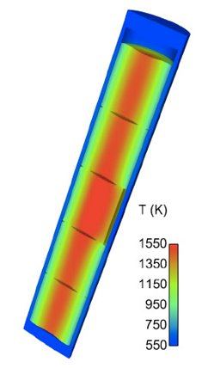
Demonstration: Initial Loading Simplified Problem
Settings:
1/4th of the core (PWR)
56 variables (56 assembly locations to arrange)
5 Materials (5 assembly types to “choose” from):
Material - 1: Enrichment 2.2% in U235, No burnable poisons
Material – 2: Enrichment 2.5% in U235, No burnable poisons
Material – 3: Enrichment 2.5% in U235, burnable poisons (8.e-06 #/(cm*barn))
Material – 4: Enrichment 3.5% in U235, No burnable poisons
Material – 5: Enrichment 3.5% in U235, burnable poisons (8.e-06 #/(cm*barn))
Objective:
Maximization of cycle length
The cycle length is determined based on a criticality search calculation (Soluble Boron Search): if SB <= 5 ppm, cycle ends
2D – Benchmark configuration
11

Slide 12
Demonstration: Initial Results
Optimal solution:
Solution:
5 1 2 3 4 5 5 5 5 5 5 5
5 5 5 5 5 5 5 5 5 5 5 5
5 5 5 5 5 5 5 5 5 5 5 5
5 5 5 5 5 5 5 5 5 5 5 5
5 5 5 5 5 5 5 5
Optimal Value:
598.9 days
12

Slide 13
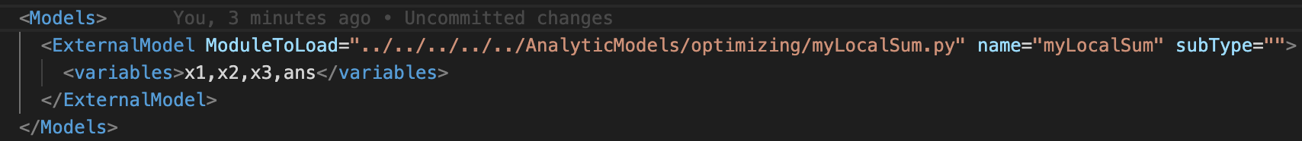
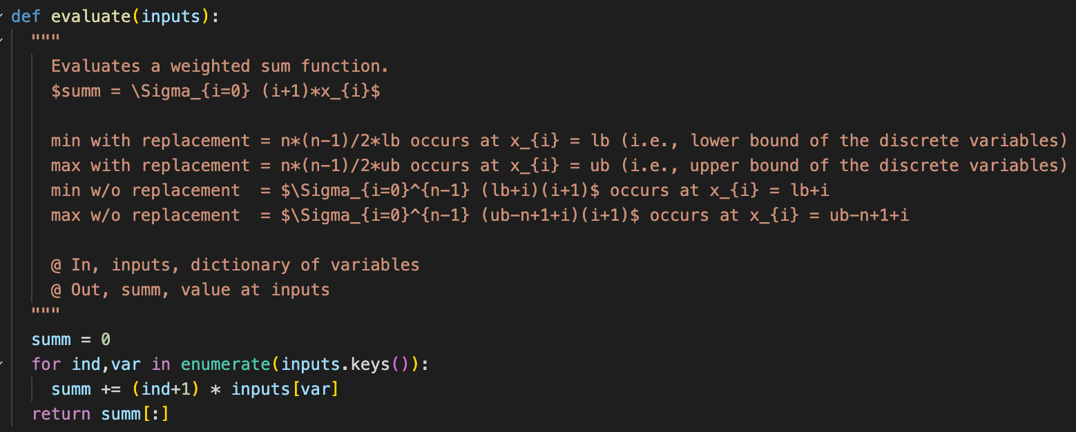
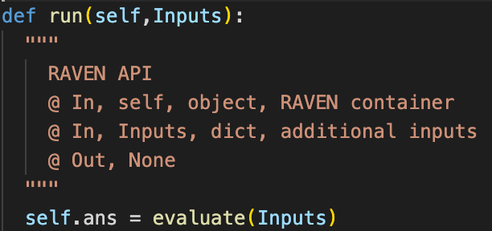
User-defined objective function via external models
RAVEN XML Input
External Model
13

Slide 14
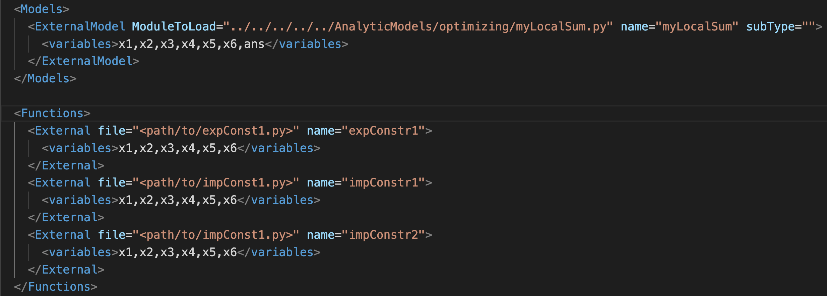
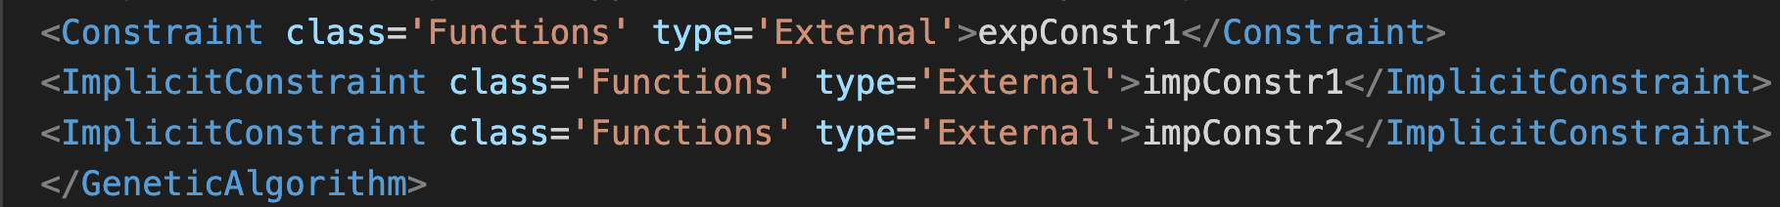
User-defined Constraints in the external model/and Functions
RAVEN XML Input
In <optimizer>:
14

Slide 15
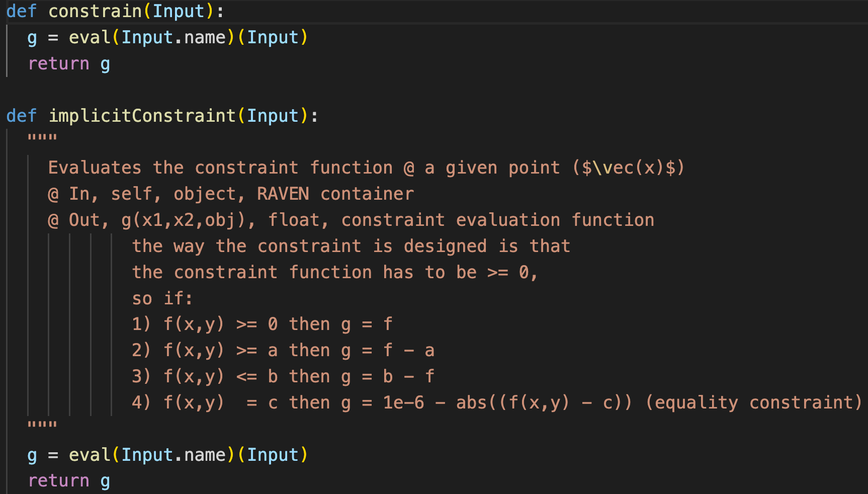
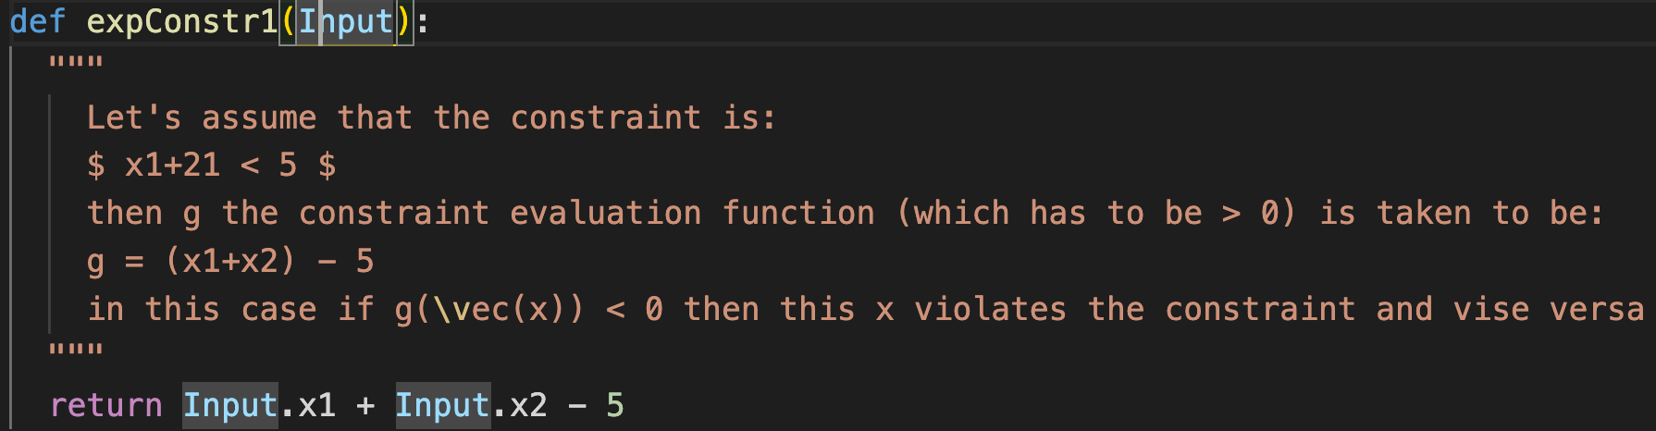
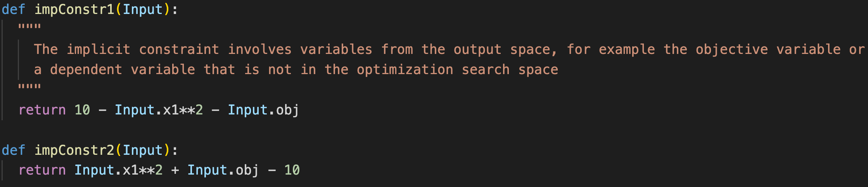
User-defined Constraints in the external model/and Functions
15

Slide 16
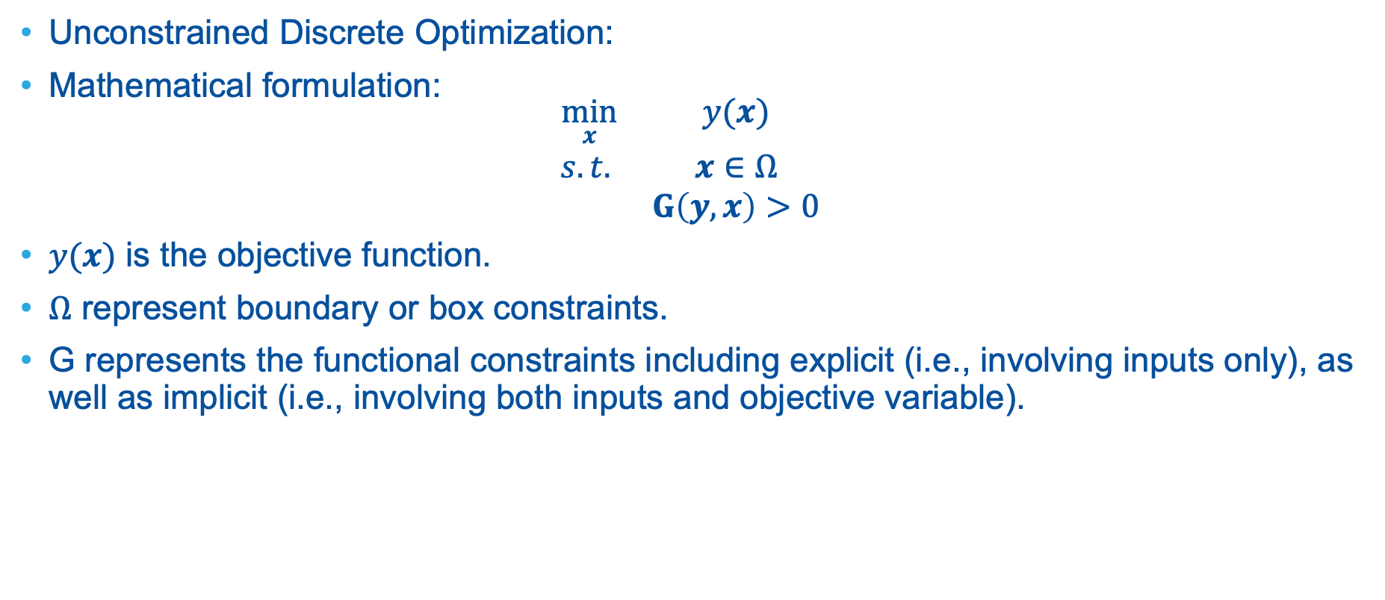
Hands-on session
Unconstrained Discrete Optimization:
Mathematical formulation:
$$\begin{matrix}\min_{x} & y(x) \\ s.t. & x∈Ω \\ & G\left(y,x\right)>0\end{matrix}$$
$y(x)$ is the objective function.
$Ω$ represent boundary or box constraints.
G represents the functional constraints including explicit (i.e., involving inputs only), as well as implicit (i.e., involving both inputs and objective variable).
16

Slide 17
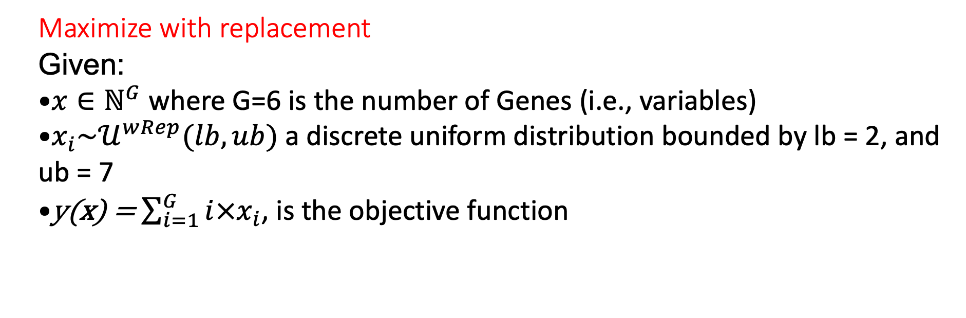
Exercise1 (1_GA_MaxwRep.xml)
Maximize with replacement
Given:
$x∈ℕ^{G}$ where G=6 is the number of Genes (i.e., variables)
$x_{i}\sim 𝒰^{wRep}(lb,ub)$ a discrete uniform distribution bounded by lb = 2, and ub = 7
y(x) = $\sum_{i=1}^{G}{i×x_{i}}$, is the objective function
17

Slide 18
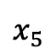
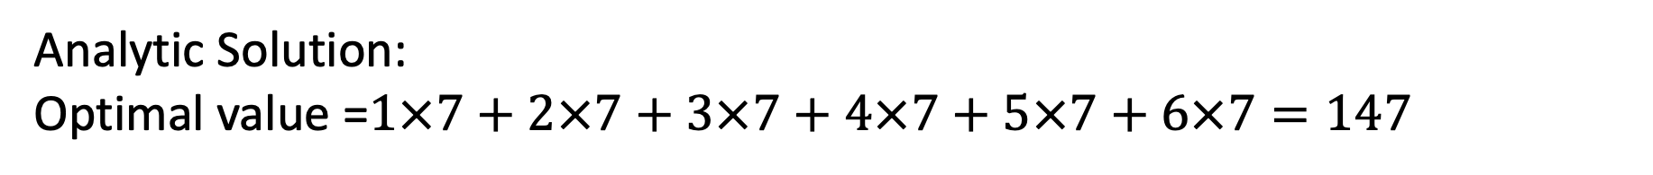
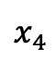
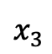
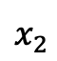
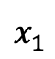
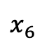
Exercise1 (1_GA_MaxwRep.xml)
Procedure: change directory (cd) to: ~/projects/raven/doc/workshop/Optimizer/GeneticAlgorithms/exercises/
Add a uniform discrete distribution that uses a “withReplacement” strategy.
Enable ‘onePointCrossover’ to occur 80% of the time and ‘swap mutation’ 90% of the time.
Build your objective function shown in the starter xml.
Add an objective function name in the xml that is consistent with your external model.
Analytic Solution:
Optimal value =$1×7+2×7+3×7+4×7+5×7+6×7=147$
7 | 7 | 7 | 7 | 7 | 7
$$x_{1}$$
$$x_{2}$$
$$x_{3}$$
$$x_{4}$$
$$x_{5}$$
$$x_{6}$$
18

Slide 19
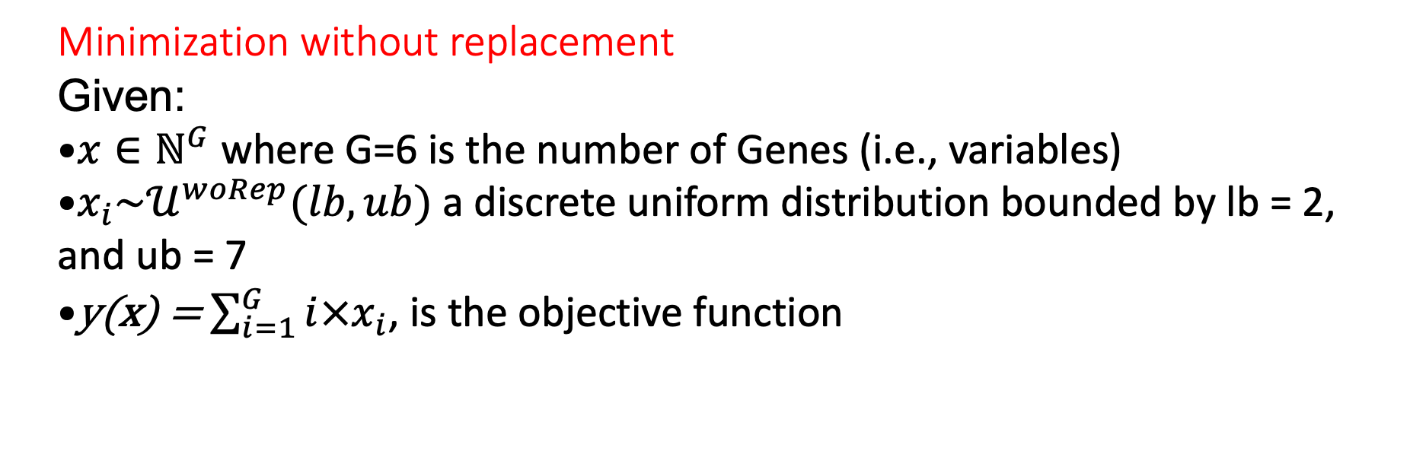
Exercise2 (2_GA_MinRep.xml)
Minimization without replacement
Given:
$x∈ℕ^{G}$ where G=6 is the number of Genes (i.e., variables)
$x_{i}\sim 𝒰^{woRep}(lb,ub)$ a discrete uniform distribution bounded by lb = 2, and ub = 7
y(x) = $\sum_{i=1}^{G}{i×x_{i}}$, is the objective function
19

Slide 20
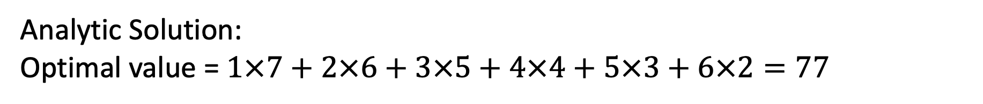
Exercise2 (2_GA_MinwoRep.xml)
Procedure:
Pick ‘rouletteWheel’ as the parent selector.
Set ‘survival selection’ criterion to ‘fitnessBased’
Set population size to 20 and max number of iterations (samplerInit limit to 15)
Run: raven_framework 2_GA_MinwoRep.xml
Analytic Solution:
Optimal value = $1×7+2×6+3×5+4×4+5×3+6×2=77$
7 | 6 | 5 | 4 | 3 | 2
$$x_{1}$$
$$x_{2}$$
$$x_{3}$$
$$x_{4}$$
$$x_{5}$$
$$x_{6}$$
20

Slide 21
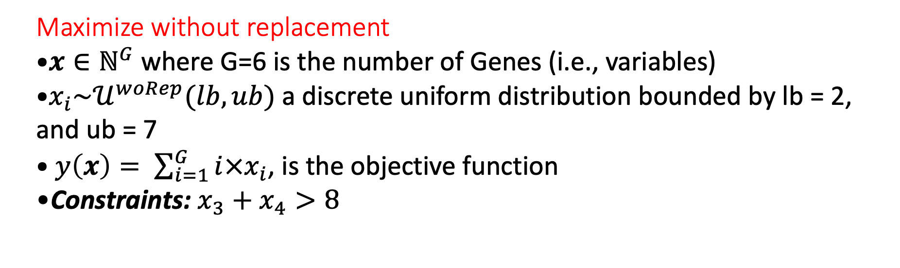
Exercise3 (Maximization with explicit constraints) start from the starter exercise 2
Maximize without replacement
$x∈ℕ^{G}$ where G=6 is the number of Genes (i.e., variables)
$x_{i}\sim 𝒰^{woRep}(lb,ub)$ a discrete uniform distribution bounded by lb = 2, and ub = 7
$y\left(x\right)= \sum_{i=1}^{G}{i×x_{i}}$, is the objective function
Constraints: $x_{3}+x_{4}>8$
21

Slide 22
Exercise3
Procedure:
Go to Models/Constraints.py and name the first function ‘constrain’ this is a must since RAVEN searches for that exact word
Give the first explicit constraint function a name and make sure it is the same name you use in the XML. And implement the constraint x3 + x4 < 8.
Look at the second explicit constraint (Not used in the exercise).
In the XML starter input, Complete the functions block to define your constraint functions.
In the fitness block, change the penalty weighting of violation b to 20.
Fill the Constraint node at the end of the GA block to reflect the name of your constraint function.
22

Slide 23
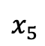
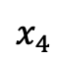
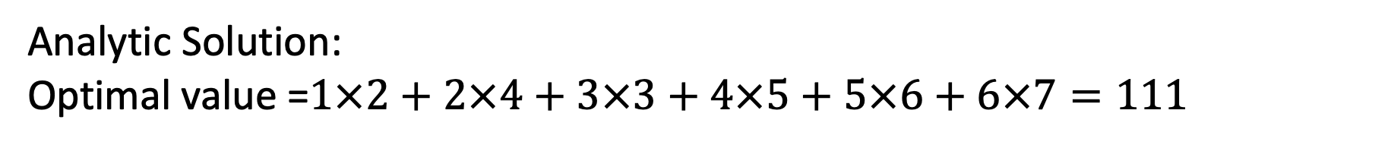
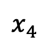
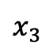
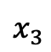
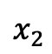
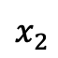
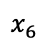
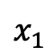
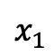
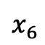
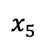
Exercise3 (Max w/o Rep with Constraints)
Analytic Solution:
Optimal value =$1×2+2×4+3×3+4×5+5×6+6×7=111$
2 | 3 | 4 | 5 | 6 | 7
2 | 4 | 3 | 5 | 6 | 7
Unconstrained:
Constrained:
$$x_{1}$$
$$x_{2}$$
$$x_{3}$$
$$x_{4}$$
$$x_{5}$$
$$x_{6}$$
$$x_{1}$$
$$x_{2}$$
$$x_{3}$$
$$x_{4}$$
$$x_{5}$$
$$x_{6}$$
Raven’s Solution:
23

Slide 24
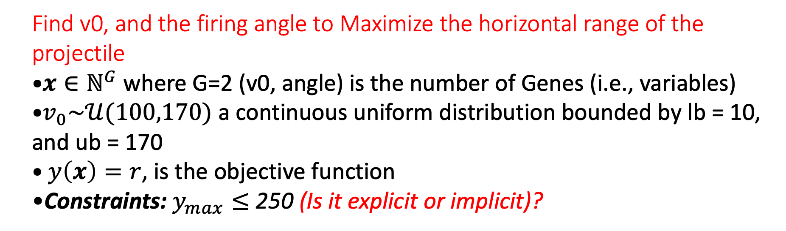
Exercise4 (Continuous problem with implicit constraint)
Find v0, and the firing angle to Maximize the horizontal range of the projectile
$x∈ℕ^{G}$ where G=2 (v0, angle) is the number of Genes (i.e., variables)
$v_{0}\sim 𝒰(100,170)$ a continuous uniform distribution bounded by lb = 10, and ub = 170
$y\left(x\right)=r$, is the objective function
Constraints: $y_{max}≤$ 250 (Is it explicit or implicit)?
24

Slide 25
Exercise4 (Continuous problem with implicit constraint)
Procedure:
Add the missing variable to the <Models>and <Functions> blocks
Change the fitness to ‘feasibleFirst’ and the weight of the penalty (b) to 20
Fill the <ImplicitConstraint> to match the <Functions>
Add the missing variable to the <DataObjects>, and <OutStreams>
25

Slide 26
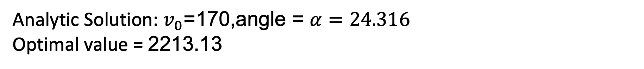
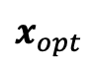
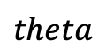

Exercise4 (Continuous problem with implicit constraint)
Analytic Solution: $v_{0}$=170,angle = $α=24.316$
Optimal value = 2213.13
170 | 24
$$x_{opt}$$
$$v0$$
$$theta$$
Raven’s Solution:
26

Slide 27


Exercise4 (Continuous problem with implicit constraint)
27

Slide 28
Backup Slides
28

Slide 29

Analytic Solutions
29

Slide 30

Enhancements and Acceleration
Exploring the active subspace hosting the search directions that increase the fitness then constrain the mutation to these directions.
Accelerate GA with Markov Chains.
Recast the problem as a reinforcement learning problem:
Objective: Maximize Cycle length or minimize # feeds.
Constraints: enrichment, number of GAD/burnable poison, K_{inf}, PPF, FDH, …
Action Space: Discrete fuel inventory
State Space: Fuel enrichment in each location.
Game Rules:
Do not violate constraints.
Do not place specific fuels next to each other (e.g., no GAD fuels horizontally or vertically adjacent).
Hybridizing and/or benchmarking with other metaheuristic methods: Particle Swarm, Ant colony, Bee algorithms, etc.
30

Slide 31



Slide 32
Thank you for your attention

Slide 33








